Slide 1
Skills Bootcamp Classroom Rules
Be on time: Just like in a physical classroom, it's important to be punctual for your online class. Log in to the virtual classroom a few minutes before the class starts.
Turn Cameras on: In order to maximise your learning studies show that being able to see your peers and your tutor being able to see you can increase motivations and retention, therefore we ask to keep your cameras on.
Attend all classes: In order to be successful in your bootcamp studies you need to attend all live sessions, therefore you should prioritise and make time for these sessions.
Avoid distractions: Turn off your phone notifications, close any other unnecessary tabs, and focus solely on the class.
Participate actively: It's important to be an active participant in the class. Ask questions, answer questions, and participate in discussions.
Use proper language and tone: Use respectful language and tone when communicating with your classmates and instructor. Avoid using slang or inappropriate language.
Respect others' opinions: Be respectful of others' opinions, even if they differ from your own. Avoid making negative comments or attacking others.
Follow the instructor's guidelines: Follow the instructor's guidelines, such as submitting assignments on time.
Be polite: Be polite and respectful to everyone in the class, including the instructor, classmates, and guest speakers.
Dress appropriately: Even though you are not in a physical classroom, it's important to dress appropriately. Dress as if you were going to a face-to-face class.
Use appropriate technology: Ensure that you have the necessary equipment, such as a reliable internet connection, a microphone, and a webcam, and that they are in good working condition.

Slide 2
Software Developer Bootcamp
Unit 1 – Introduction to Software Development
Week 2A

Slide 3
Learning Outcomes
By the end of this session, you will be able to:
Describe the SDLC – its purpose and structure.
Describe the stages of the SDLC and give a summary of what goes on at each stage.
Describe the INPUTS and OUTPUTS of the SDLC phases.
Describe the WATERFALL development model, its process, and its advantages and disadvantages.
Understand what a variable and how to create one.
Notes:
By the end of this session, you should possess a nuanced understanding of the Software Development Life Cycle and the Waterfall Model. This includes a thorough grasp of their stages, inputs, outputs, and the merits and demerits of the Waterfall Model.

Slide 4
Describe the SDLC – its purpose and structure

Slide 5
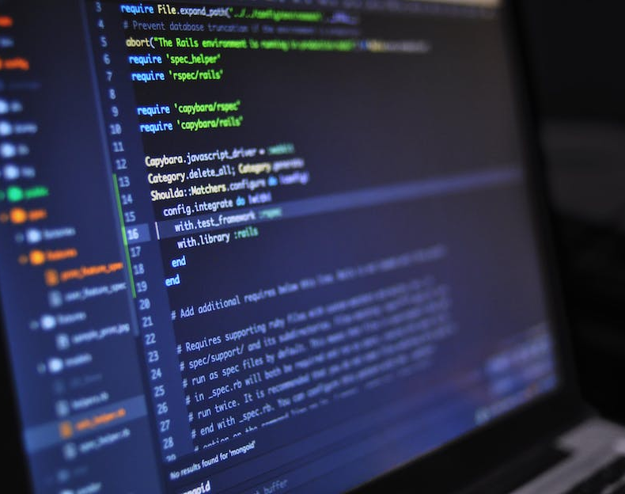
What is the SDLC?
The System Development Life Cycle (SDLC) is a process used by software engineers to plan, design, develop, test, and deploy software applications.
It is a structured approach to software development that helps ensure that the software meets the customer's needs and is delivered on time and within budget.
The SDLC is a series of steps – depending upon the version of the cycle you look at, there may be between 4 and over a dozen steps!
However, whichever version of the SDLC you examine, you will see a common set of activities involved.
Notes:
The Software Development Life Cycle, commonly abbreviated as SDLC, is a systematic, structured framework used for guiding the creation and maintenance of high-quality software. It is not merely a methodology but a paradigm that ensures the software meets or exceeds customer expectations, reaches completion within times and cost estimates, and is maintainable.

Slide 6

The SDLC Video

Slide 7

Purpose of the SDLC
The purpose of the SDLC is to provide a framework for software development that is repeatable, efficient, and cost-effective.
It helps to ensure that the software is developed in a systematic and organized manner, and that all stakeholders are involved in the process.
Notes:
SDLC is multi-dimensional. Firstly, it aims to assure the quality of the software by aligning the development process with user requirements and industry standards. Secondly, it provides a cost-efficient route to software development by enabling optimal resource allocation and eliminating redundant tasks. Lastly, it ensures that the project adheres to predefined timelines, thereby mitigating the risks associated with delayed project delivery.

Slide 8
Structure of SDLC
The seven main phases:
Planning
Analysis
Design
Develope
Testing
Deployment
Maintenance.
Notes:
The SDLC is generally demarcated into seven pivotal stages, each with its own set of activities, objectives, and deliverables. These stages collectively contribute to the development of software that is not only functional but also reliable, maintainable, and aligned with user requirements.

Slide 9
Diagram of SDLC
1
PLANNING
7
MAINTENANCE
ANALYSIS
2
DEPLOYMENT
DESIGN
6
3
TESTING
DEVELOPMENT
5
4

Slide 10
1 - PLANNING
Important information needs to be identified and decided upon:
Establish the rationale for the development and the benefits it will bring.
Estimate the cost
Confirm the scope of the development
Identify any risks
What resources are needed (people, skills, hardware, software, etc.)
What the basic requirements for the software are…
Then a PLAN of the development process is produced:
Planning WHO will do what,
Planning WHEN things will happen
Notes:
The Planning stage serves as the bedrock upon which the entire project is built. It involves a triad of critical activities. Firstly, it necessitates the setting of clear, measurable objectives that the software is expected to achieve. Secondly, it requires the meticulous allocation of resources, including human capital, technology, and finances, to ensure that the project is both viable and sustainable. Lastly, it mandates the establishment of a realistic, achievable timeline within which the project is expected to reach fruition.

Slide 11

2 - ANALYSIS
At this stage of the cycle, the software development is carefully ANALYSED to ensure it is fully understood.
The process typically involves:
GATHER DETAILED REQUIREMENTS,
ANALYSE the information gathered,
Confirm the requirements for the software, by producing a SPECIFICATION.
This stage of the SDLC is commonly described as the MOST IMPORTANT of all the stages
Notes:
The Analysis stage is a linchpin in the SDLC framework. It involves two primary activities. The first is the gathering of detailed requirements, both software and system, from various stakeholders, including end-users, managers, and clients. This ensures that the software is aligned with user needs and expectations. The second activity is the conduct of a feasibility study, which evaluates the project's viability from multiple dimensions, including economic feasibility, technical feasibility, and operational feasibility.

Slide 12
2 - ANALYSIS
A bit more detail:
GATHER DETAILED REQUIREMENTS
Research in depth what the CUSTOMER and/or USERs need the software to do or have. i.e. gathering lots of information that fully explains how the software needs to function and perform.
ANALYSE the information gathered
Look carefully at all the information gathered, and decide on it’s importance and whether what has been asked for is feasible.
A common technique is called MoSCoW. → TASK: Look up what this is!
Confirm the requirements for the software, by producing a SPECIFICATION.
Typically a specification is a written document that lists all the REQUIREMENTS for the software (i.e. what it will be required to do/have). This ‘spec’ document is the reference point for all other work in the SDLC from this point! For this reason, it is important to get it agreed (VALIDATED) by the customer…

Slide 13
3 - DESIGN
Once the SPECIFICATION is confirmed, you can start to design how the software will be created to meet the requirements.
This involves planning how the different elements of the software will be created. For example:
USER INTERFACE (UI) – sketching WIREFRAMES or STORYBOARDS of how the UI will look and function
CODE – producing flowcharts, pseudocode or other ways to show the LOGIC of how the code should flow and function
DATA STORAGE – producing designs for how the data stored by the software should be stored, and in what format.
Most importantly, the designs should meet the requirements set out in the specification!
Notes:
The Design stage serves as the crucible where the abstract requirements gathered during the Analysis stage are transformed into a concrete operational model. The first step involves the creation of an architectural design, which serves as a blueprint for the entire software system. This is followed by the definition of data structures, algorithms, and interfaces, which specify how data will be stored, processed, and accessed, thereby laying the groundwork for the subsequent Implementation stage.

Slide 14

4 - DEVELOPMENT
At this stage of the SDLC, the requirements are understood and documented, and the software has been designed. So now the software is created (CODED).
SOFTWARE DEVELOPERS write code to create the various different parts of the software, following the DESIGNS created previously.
The code will be run regularly to check that it is working as expected.
On large developments, multiple developers might work concurrently (at once).
Notes:
The Implementation stage is where the rubber meets the road. It involves the translation of the design blueprint into actual, machine-readable code. This is a meticulous process that requires a high level of expertise and attention to detail. Once the coding is completed, the next step is Unit Testing, where each individual component of the software is tested to ensure that it functions in accordance with its design specifications.

Slide 15

5 - TESTING
Once all the designs have been created into a working piece of software (known as the PRODUCT or SOLUTION), it is vital that the software is TESTED.
Testing is typically conducted by running the software and checking that it meets the REQUIREMENTS set out in the SPECIFICATION.
Anything that doesn’t work as expected is known as a BUG and must be fixed.
Testing ensures that the software is FIT FOR PURPOSE, and a quality product. In fact, testing can also be called QUALITY ASSURANCE.
Notes:
The Testing stage serves as the quality control mechanism for the entire software development process. It involves multiple types of testing, each serving a specific purpose. Unit Testing ensures that individual components function as intended. Integration Testing verifies that these components work in harmony. System Testing checks the software's overall functionality, and Acceptance Testing confirms that it meets user requirements. Concurrently, any bugs or errors identified are fixed to ensure the highest level of quality.

Slide 16
6 - DEPLOYMENT
At this stage in the SDLC, the software has been made and tested to ensure that it does everything it should – so it will be released/deployed to the customer/users.
i.e. the software ‘goes live’. Other terms for deployment are ‘rollout’ or ‘implementation’.
These days software is deployed via a variety of methods:
User installation into an operating system environment,
Uploading to a server for users to connect to,
Distribution via CD/DVD/Blu-ray disk,
Making available for download via an ‘app store’ or website,
Remote installation by technical staff
Training/training materials for the new software may also be distributed
Notes:
The Deployment stage marks the transition of the software from a development setting to a live environment. This involves choosing an appropriate deployment strategy, which could range from a phased rollout to a full-scale implementation. Additionally, end-users may require training to use the software effectively, thereby ensuring that the software not only becomes operational but also usable and effective.

Slide 17
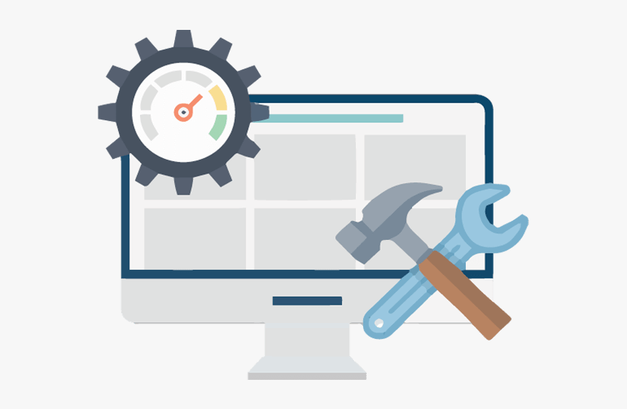
7 - MAINTENANCE
The final stage of the SDLC is the longest phase – as technically it lasts until the product is retired (reaches it’s END OF LIFE)
This phase is about looking after the product while it is live and being used by USERS.
There are usually 4 types of maintenance:
CORRECTIVE – fixing problems with the software
PERFECTIVE – improving the software
ADAPTIVE – changing the software where necessary
PREVENTATIVE – changing the software to stop any future problems.
The maintenance phase of software is normally looked after by a ‘Support Team’ or similar.
Notes:
The Maintenance stage is not merely an endpoint but a continuous phase that ensures the software's long-term viability and relevance. This involves periodic updates to add new features, improve performance, or fix bugs. Patches may also be issued to address specific issues, thereby ensuring that the software remains robust, reliable, and aligned with user needs.

Slide 18
Below are examples of expected inputs and outputs…
SDLC
Stage number: | Stage name: |  | INPUTs to the stage | OUTPUTs from the stage
1 | PLANNING |  | Budget, Basic requirements, Business need for software | Project Plan
2 | ANALYSIS |  | Customer and User needs (requirements) | Specification
3 | DESIGN |  | Specification | Design Documents
4 | DEVELOPMENT |  | Design Documents | Coded Product
5 | TESTING |  | Coded Product, Specification (to test against) | Tested (Releasable) Product
6 | DEPLOYMENT |  | Releasable Product | Live (Released) Product
7 | MAINTENANCE |  | Live (Released) Product | Updated Product

Slide 19
Software Development Approaches
We have already discussed the general SDLC as a process to develop software – however, this is just a theoretical ‘textbook’ strategy or approach.
i.e. the SDLC is a general, high-level ideal of how software developments work, but it doesn’t describe exactly how real software development teams actually work.
In the real world, there are many different specific MODELS or METHODOLOGIES that are based upon the principles of the SDLC.
These models can roughly be split into SEQUENTIAL and ITERATIVE approaches…
* Note: ITERATIVE approaches will be covered later in the course.

Slide 20
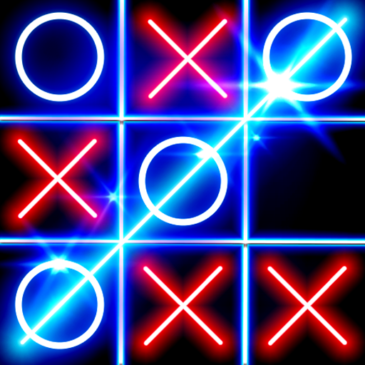
AI Tic-Tac-Toe game
In each of SDLC stages there is a team consisting of the below roles:
Project Manager
Software Architect
Software Developer
Software Tester
User Experience Designer
Technical Writer
Create a team for each stage and describe how each role will be implicated in each of the SDLC stages.
What to consider:
What AI features would you incorporate into your game? What platform(s) will you use? What are you game rules? At what stage(s) will you make sure everything is going according to plan?

Slide 21
Waterfall Development Model

Slide 22
The WATERFALL model
WATERFALL
The WATERFALL model was the first real-world software development model.
It was created several decades ago and has it’s roots in manufacturing and construction.
→ TASK: When was the Waterfall Model created, and by whom?
Notes:
The Waterfall Model is a specific instantiation of the SDLC that is characterised by its linear and sequential approach. Each phase must be completed before the next begins, making it one of the simplest and easiest methodologies to understand and implement. However, this simplicity comes with its own set of advantages and disadvantages, which we shall explore.

Slide 23

The Waterfall model Video

Slide 24
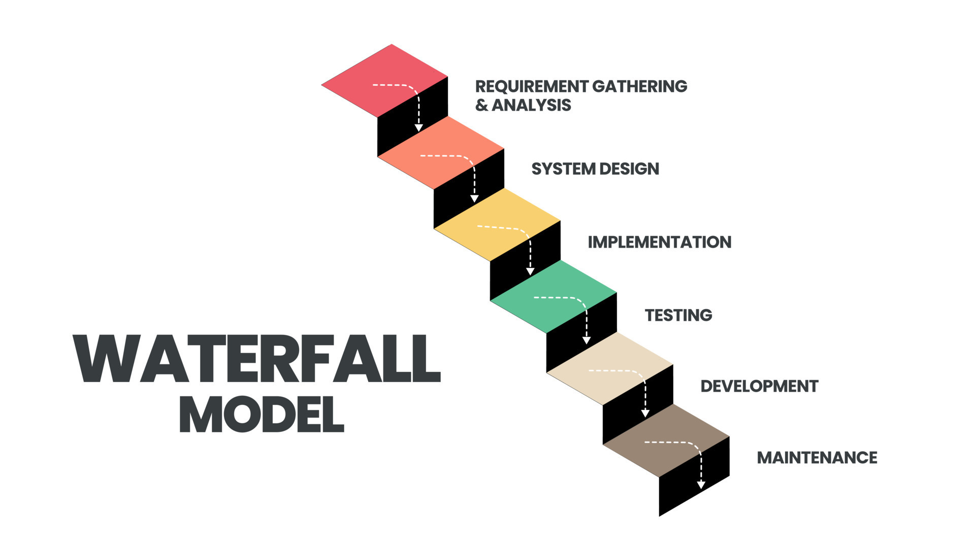
→ TASK: READ this webpage: https://www.umsl.edu/~hugheyd/is6840/waterfall.html
Notes:
The Waterfall Model adheres to a strict, linear sequence of phases, each culminating in a milestone that serves as a checkpoint for assessing project progress. Unlike the SDLC, which allows for iterative feedback and adjustments, the Waterfall Model is rigid in its sequence, thereby necessitating a high level of accuracy and completeness in each phase.

Slide 25
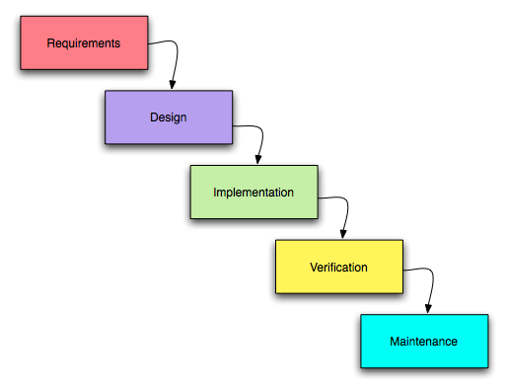
WATERFALL: A SEQUENTIAL development process
WATERFALL
Waterfall Model
Process flows downwards like a waterfall
Characterized by
- Sequential steps (phases)
No changes to previous steps/work allowed
Customer only involved at the beginning and at delivery.
Documentation-driven
Notes:
https://www.umsl.edu/~hugheyd/is6840/waterfall.html

Slide 26

The Waterfall Model Process
Step 1: Conception and Initiation - This is the first step in the process, where the project is conceived and initiated.
Step 2: Analysis - This is the second step in the process, where the project is analyzed and requirements are gathered.
Step 3: Design - This is the third step in the process, where the project is designed.
Step 4: Construction - This is the fourth step in the process, where the project is constructed.
Step 5: Testing - This is the fifth step in the process, where the project is tested.
Step 6: Production/Implementation - This is the sixth step in the process, where the project is implemented.
Step 7: Maintenance - This is the seventh and final step in the process, where the project is maintained.
Notes:
The Waterfall Model adheres to a strict, linear sequence of phases, each culminating in a milestone that serves as a checkpoint for assessing project progress. Unlike the SDLC, which allows for iterative feedback and adjustments, the Waterfall Model is rigid in its sequence, thereby necessitating a high level of accuracy and completeness in each phase.

Slide 27
When to Use the Waterfall Model
The Waterfall Model is best used when the requirements are very well understood and are unlikely to change.
It is also best used when the project is relatively small, and the technology is well understood.
It is also best used when there is a need for strict control over the project and its progress.

Slide 28
Advantages of the Waterfall Model
The Waterfall Model is easy to understand and use.
It is easy to manage due to its rigid structure.
It allows for departmentalization and control.
It is easy to measure progress.
It allows for early error detection.
Notes:
The Waterfall Model, despite its simplicity, offers several advantages that make it suitable for certain types of projects. Its linear and sequential nature makes it easy to understand and manage, thereby reducing the complexity associated with project management. Additionally, each stage is well-defined with specific deliverables, making it easier to monitor and assess project progress.

Slide 29
Disadvantages of the Waterfall Model
However, the Waterfall Model is not without its drawbacks:
1. Lack of Flexibility: The linear sequence makes it difficult to go back and make changes.
2. High Risk: If requirements are not well understood, the project can easily go off track.
Notes:
The Waterfall Model, while advantageous in certain contexts, has significant drawbacks that limit its applicability. The lack of flexibility inherent in its linear sequence makes it difficult to go back and make changes once a phase has been completed. This rigidity can be particularly problematic if the project requirements are not well-understood or change over time, thereby increasing the risk of project failure.

Slide 30
Python naming conventions
In programming, there are naming conventions that should be followed to make it easier to read and understand your code.
Python has an agreed set of conventions that programmers should follow.
You will explore some of these during this lesson.
age
first_name
SPEED

Slide 31
What is a variable?
A variable holds a value in a memory location that is needed for the execution of your program.
A variable can hold one value at a time. This value can change throughout the execution of the program.

Slide 32
What is a variable?
You might use a variable to keep track of the score for a game.
At the beginning of a game the score might be 0.
score
0

Slide 33
What is a variable?
You might use a variable to keep track of the score for a game.
At the beginning of a game the score might be 0.
During gameplay, the player might earn a point.
score
0
score = score + 1

Slide 34
What is a variable?
You might use a variable to keep track of the score for a game.
At the beginning of a game the score might be 0.
During gameplay, the player might earn a point.
This would change the value held in score by increasing the value by 1.
score
1
score = score + 1

Slide 35

Using a variable
A memory location needs to be allocated for the variable value, before it can be used by the program.
Declaring a variable means stating what data type will be used for the value.
Initialising a variable means setting the initial value.
Notes:
Image source: https://pixabay.com/photos/post-post-office-letter-old-3471110/

Slide 36
Variable declaration in other programming languages
Python doesn’t use variable declaration, only initialisation.
Here are examples of variable declaration in Visual Basic and C.
Integer or int just means whole numbers.
Both of these statements mean declare the variable age as an integer.
Visual Basic
Dim age As Integer
C
int age;

Slide 37
Variable initialisation
Initialisation is when the initial value is assigned to the variable.
Remember that variables only hold one value at a time and this value can change throughout the execution of the program.
Here are examples of variable initialisation. This means hold the value 22 under the variable name, age.
Visual Basic
age = 22
C
age = 22;
Python
age = 22

Slide 38
Creating and using our first variable
Line 1 initialises the variable by calling it name and assigning the value “Gerry” at a memory location.
Activity
Type this code into Python and run it to see what happens.
Swap lines 1 and 2 around and read the error message that occurs.
1
2
3
name="Gerry"
print(name)
Notes:
https://replit.com/~ (SET LANGUAGE TO PYTHON)

Slide 39
Creating and using our first variable
When you try to use a variable before it has been initialised, it will cause an error.
Instructions are executed one after the other.
In this case the error would be:
name, ‘name’ is not defined
1
2
3
print(name)
name="Gerry"
Traceback (most recent call last):
File "c:\users\rebecca\mu_code\name.py", line 1, in <module>
print(name)
NameError: name 'name' is not defined

Slide 40
Creating and using our first variable
Once a variable has been initialised with its first value, it can then be reassigned a new value throughout the execution of the code.
Question .
What do you think might happen when this code is executed?
1
2
3
name="Gerry"
name="Sam"
print(name)

Slide 41
Creating and using our first variable
The program will display Sam on the screen. This is because it was the last value that was assigned to name.
1
2
3
name="Gerry"
name="Sam"
print(name)
Sam
>>>

Slide 42

Meaningful identifiers and naming conventions
Variables should always be identified in a meaningful way, like the files from the starter activity.
a, b, c, x, y are not helpful names for a variable.
If a variable is going to hold a name, then call that variable name.
x = "Gerry"
name = "Gerry"
Notes:
Image source: https://pixabay.com/vectors/check-cross-red-green-attention-158879/

Slide 43
Meaningful identifiers and naming conventions
All programming languages have their own naming conventions.
A considerate programmer will read the documentation for the programming language to find out what the conventions are.
In Python, variable names should be written in lower case, with an underscore separating words if required.

Slide 44

Recap
Declaration means to declare a variable as a certain data type.
Initialisation means to set an initial value for a variable.
Assignment means to change the value held at the variable location.
A variable must be initialised before it can be used.
Meaningful identifiers are essential.

Slide 45
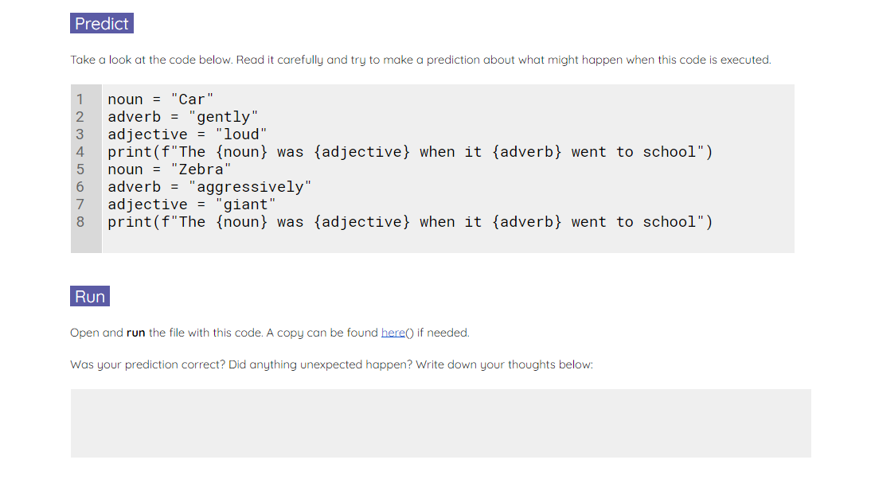
Silly sentences
Use the Activity 2 worksheet to predict, run, investigate, and modify a silly sentences program.
The final task is to create your own silly story.
Notes:
A2 Worksheet – Silly sentences

Slide 46
Learning Outcomes
By the end of this session, you will be able to:
Describe the SDLC – its purpose and structure.
Describe the stages of the SDLC and give a summary of what goes on at each stage.
Describe the INPUTS and OUTPUTS of the SDLC phases.
Describe the WATERFALL development model, its process, and its advantages and disadvantages.
Understand what a variable and how to create one.

Slide 47
Thank you.
Any questions?

